Slide 1

Feature Engineering for ML
Dmitry Larko
Sr Data Scientist H2O.ai @DmitryLarko

Slide 2
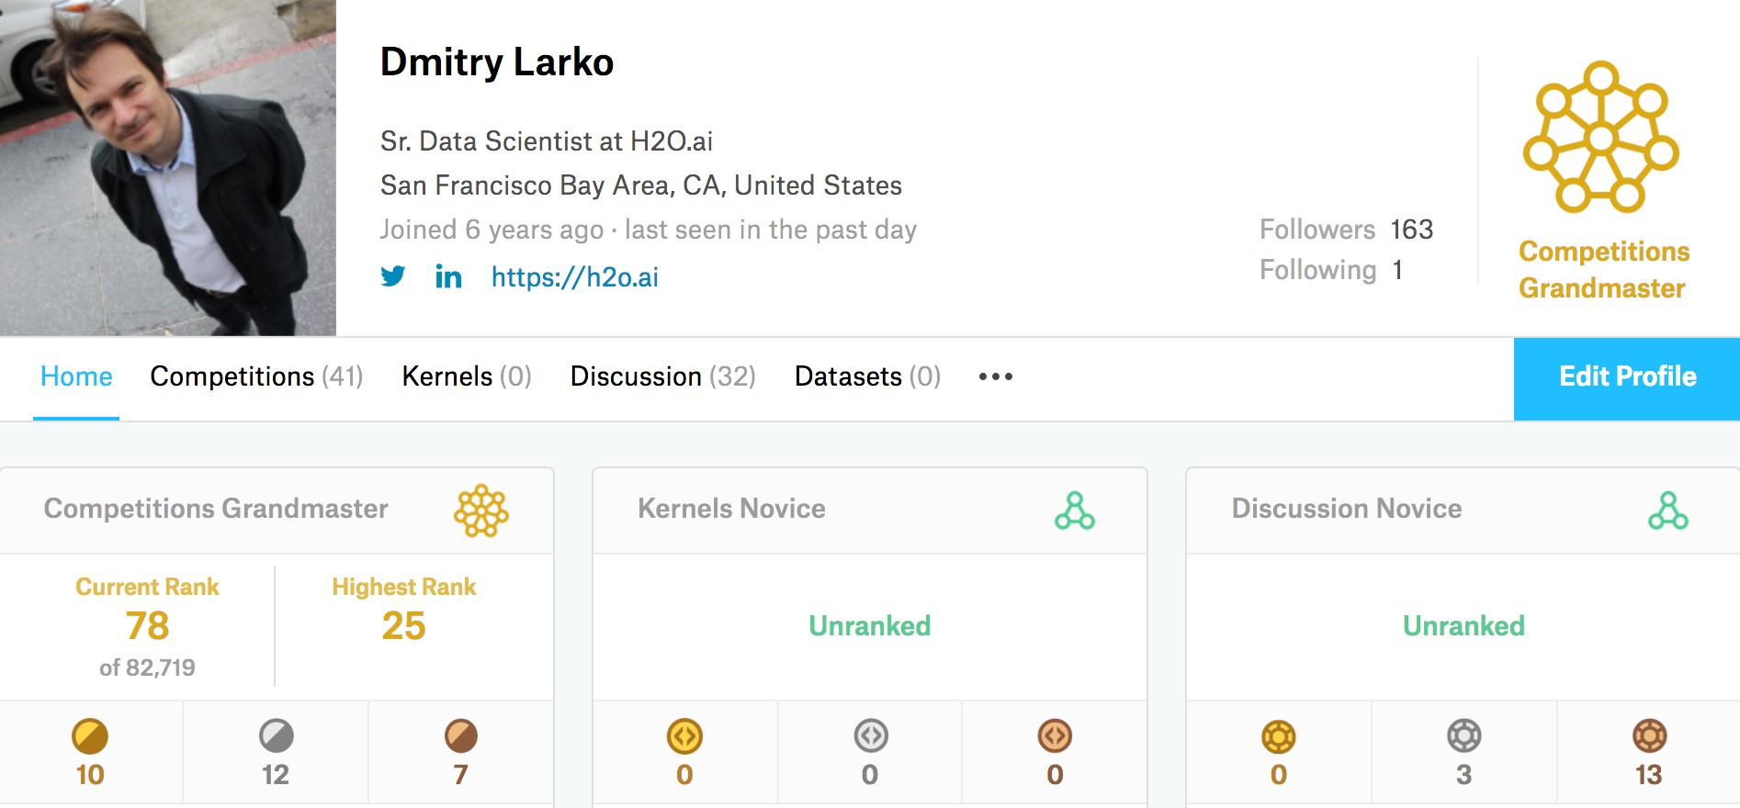
About me

Slide 3
Feature Engineering
"Coming up with features is difficult, time-consuming, requires expert knowledge. “Applied machine learning” is basically feature engineering." ~ Andrew Ng
“… some machine learning projects succeed and some fail. What makes the difference? Easily the most important factor is the features used.” ~ Pedro Domingos
“Good data preparation and feature engineering is integral to better prediction” ~ Marios Michailidis (KazAnova), Kaggle GrandMaster, Kaggle #3, former #1
”you have to turn your inputs into things the algorithm can understand” ~ Shayne Miel, answer to “What is the intuitive explanation of feature engineering in machine learning?”

Slide 4
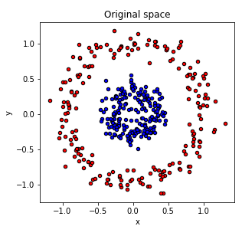
What is feature engineering
Not possible to separate using linear classifier

Slide 5
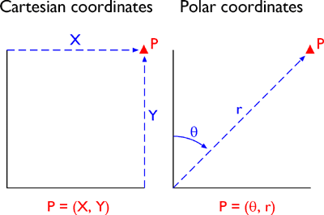
What is feature engineering
What if we use polar coordinates instead?

Slide 6
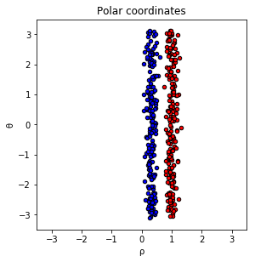
What is feature engineering

Slide 7
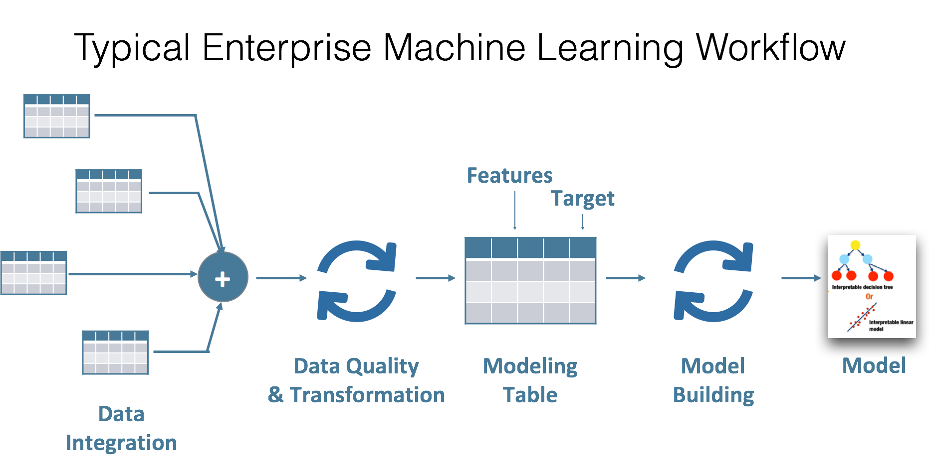
Feature Engineering

Slide 8
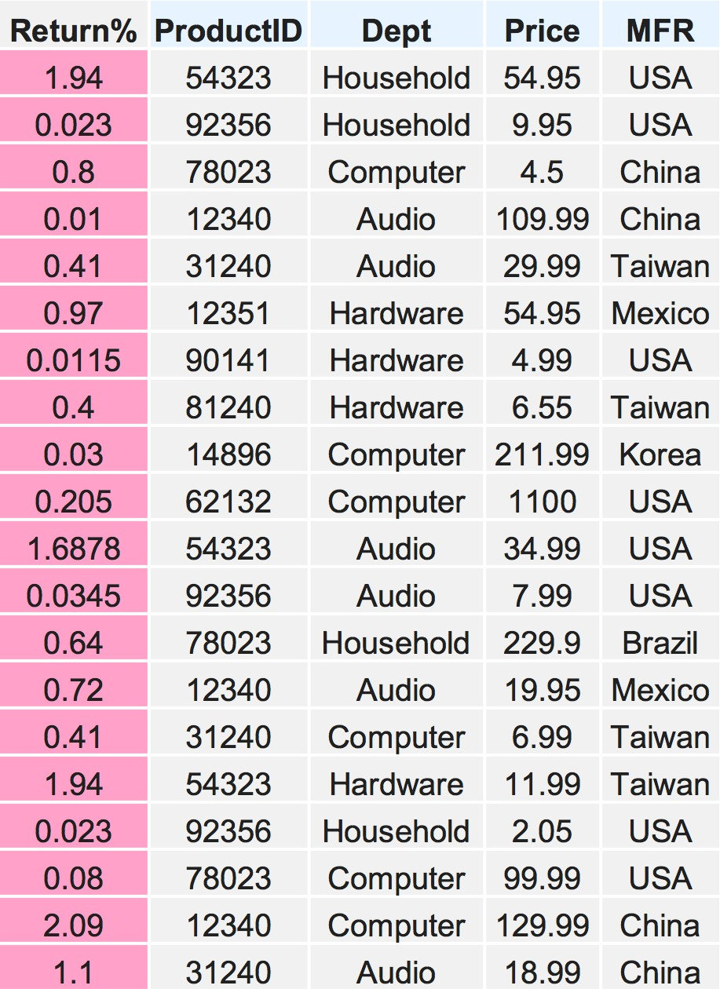
Your data

Slide 9
Your data
Target

Slide 10
Your data
Target
Categorical
Cat

Slide 11
Your data
Target
Categorical
Num Cat

Slide 12
Feature Engineering
Extract more new gold features, remove irrelevant or noisy features
Simpler models with better results
Key Elements
Numerical features
Categorical features
Target Transformation

Slide 13
Numerical features – missing values
Some machine learning tools cannot accept NAs in the input
Binary features
-1 for negatives, 0 for missing values and 1 for positives
Numeric features
Tree-based methods
Encode as a big positive or negative number
999, -99999, ….
2*max(x), 2*min(x)
Linear, neural nets, etc. methods
Encode by splitting into 2 columns:
Binary column isNA (0 if not and 1 if yes)
In original column replace NAs by mean or median

Slide 14
Numerical features – missing values
Binary | Numerical
 | ver 1: 2*max | ver 2: mean and isNA
 |  | Value | isNA
1 | 18 | 5.14 | 1
-1 | 6 | 6 | 0
1 | 5 | 5 | 0
0 | 8 | 8 | 0
-1 | 0 | 0 | 0
-1 | 18 | 5.14 | 1
1 | 9 | 9 | 0
0 | 3 | 3 | 0
-1 | 5 | 5 | 0
Binary | Numerical
1 | NaN
0 | 6
1 | 5
NaN | 8
0 | 0
0 | NaN
1 | 9
NaN | 3
0 | 5

Slide 15
Categorical features – missing values
Encode as an unique category
“Unknown”, “Missing”, ….
Use the most frequent category level
Feature 1 | Encoded Feature 1 | Encoded Feature 1
A | A | A
A | A | A
NaN | MISSING | A
A | A | A
B | B | B
B | B | B
NaN | MISSING | A
C | C | C
C | C | C

Slide 16
Categorical Encoding
Turn categorical features into numeric features to provide more fine-grained information
Help explicitly capture non-linear relationships and interactions between the values of features
Most of machine learning tools only accept numbers as their input
xgboost, gbm, glmnet, libsvm, liblinear, etc.

Slide 17
Categorical Encoding
Labeled Encoding
Interpret the categories as ordered integers (mostly wrong)
Python scikit-learn: LabelEncoder
Ok for tree-based methods
One Hot Encoding
Transform categories into individual binary (0 or 1) features
Python scikit-learn: DictVectorizer, OneHotEncoder
Ok for K-means, Linear, NNs, etc.

Slide 18
Categorical Encoding
Labeled Encoding
A | 0
B | 1
C | 2
Feature 1 | Encoded Feature 1
A | 0
A | 0
A | 0
A | 0
B | 1
B | 1
B | 1
C | 2
C | 2

Slide 19
Categorical Encoding
One Hot Encoding
A | 1 | 0 | 0
B | 0 | 1 | 0
C | 0 | 0 | 1
Feature | Feature = A | Feature = B | Feature = C
A | 1 | 0 | 0
A | 1 | 0 | 0
A | 1 | 0 | 0
A | 1 | 0 | 0
B | 0 | 1 | 0
B | 0 | 1 | 0
B | 0 | 1 | 0
C | 0 | 0 | 1
C | 0 | 0 | 1

Slide 20
Categorical Encoding
Frequency Encoding
Encoding of categorical levels of feature to values between 0 and 1 based on their relative frequency
A | 0.44 (4 out of 9)
B | 0.33 (3 out of 9)
C | 0.22 (2 out of 9)
Feature | Encoded Feature
A | 0.44
A | 0.44
A | 0.44
A | 0.44
B | 0.33
B | 0.33
B | 0.33
C | 0.22
C | 0.22

Slide 21
Categorcial Encoding - Target mean encoding
Instead of dummy encoding of categorical variables and increasing the number of features we can encode each level as the mean of the response.
A | 0.75 (3 out of 4)
B | 0.66 (2 out of 3)
C | 1.00 (2 out of 2)
Feature | Outcome | MeanEncode
A | 1 | 0.75
A | 0 | 0.75
A | 1 | 0.75
A | 1 | 0.75
B | 1 | 0.66
B | 1 | 0.66
B | 0 | 0.66
C | 1 | 1.00
C | 1 | 1.00

Slide 22
Categorical Encoding - Target mean encoding
Also it is better to calculate weighted average of the overall mean of the training set and the mean of the level:
𝜆 𝑛 ∗ 𝑚𝑒𝑎𝑛 𝑙𝑒𝑣𝑒𝑙 + 1 − 𝜆 𝑛 ∗ 𝑚𝑒𝑎𝑛(𝑑𝑎𝑡𝑎𝑠𝑒𝑡)
The weights are based on the frequency of the levels i.e. if a category only appears a few times in the dataset then its encoded value will be close to the overall mean instead of the mean of that level.

Slide 23
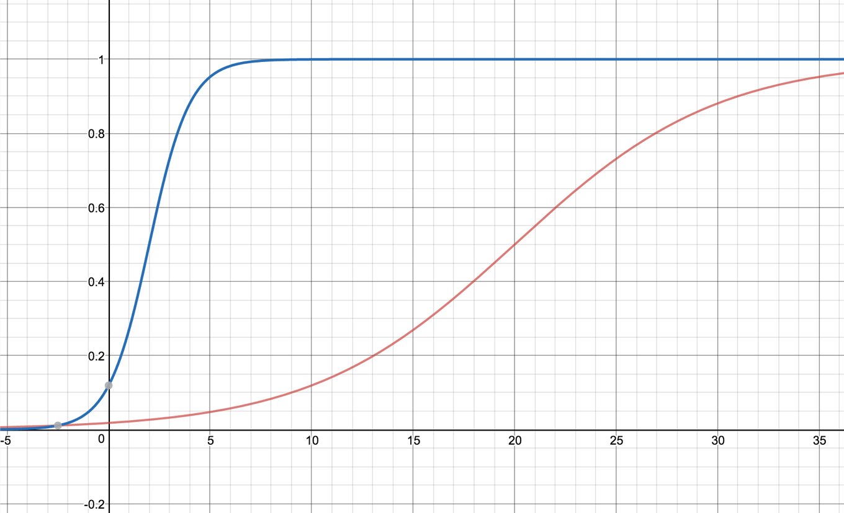
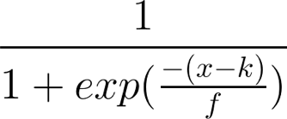

Categorical Encoding – Target mean encoding 𝜆 𝑛 example
x = frequency k = inflection point
f = steepness
https://www.desmos.com/calculator

Slide 24
Categorical Encoding - Target mean encoding - Smoothing
1
𝜆 =
1 + exp(− ^{𝑥 − 2} )
0.25
 | x | level | dataset | 𝜆
A | 4 | 0.75 | 0.77 | 0.99 | 0.99*0.75 + 0.01*0.77 = 0.7502
B | 3 | 0.66 | 0.77 | 0.98 | 0.98*0.66 + 0.02*0.77 = 0.6622
C | 2 | 1.00 | 0.77 | 0.5 | 0.5*1.0 + 0.5*0.77 = 0.885
Feature | Outcome
A | 1
A | 0
A | 1
A | 1
B | 1
B | 1
B | 0
C | 1
C | 1
1
𝜆 =
1 + exp(−
𝑥 − 3
0.25 ⁾
 | x | level | dataset | 𝜆
A | 4 | 0.75 | 0.77 | 0.98 | 0.98*0.75 + 0.01*0.77 = 0.7427
B | 3 | 0.66 | 0.77 | 0.5 | 0.5*0.66 + 0.5*0.77 = 0.715
C | 2 | 1.00 | 0.77 | 0.017 | 0.017*1.0 + 0.983*0.77 = 0.773

Slide 25
Categorical Encoding - Target mean encoding
Instead of dummy encoding of categorical variables and increasing the number of features we can encode each level as the mean of the response.
A | 0.75 (3 out of 4)
B | 0.66 (2 out of 3)
C | 1.00 (2 out of 2)
Feature | Outcome | MeanEncode
A | 1 | 0.75
A | 0 | 0.75
A | 1 | 0.75
A | 1 | 0.75
B | 1 | 0.66
B | 1 | 0.66
B | 0 | 0.66
C | 1 | 1.00
C | 1 | 1.00

Slide 26
Categorical Encoding - Target mean encoding
To avoid overfitting we could use leave-one-out schema
Feature | Outcome |  |  | LOOencode
A | 1 |  |  | 0.66
A | 0
A | 1
A | 1
B | 1
B | 1
B | 0
C | 1
C | 1

Slide 27
Categorical Encoding - Target mean encoding
To avoid overfitting we could use leave-one-out schema
Feature | Outcome |  |  | LOOencode
A | 1 |  |  | 0.66
A | 0 |  |  | 1.00
A | 1
A | 1
B | 1
B | 1
B | 0
C | 1
C | 1

Slide 28
Categorical Encoding - Target mean encoding
To avoid overfitting we could use leave-one-out schema
Feature | Outcome |  |  | LOOencode
A | 1 |  |  | 0.66
A | 0 |  |  | 1.00
A | 1 |  |  | 0.66
A | 1
B | 1
B | 1
B | 0
C | 1
C | 1

Slide 29
Categorical Encoding - Target mean encoding
To avoid overfitting we could use leave-one-out schema
Feature | Outcome |  |  | LOOencode
A | 1 |  |  | 0.66
A | 0 |  |  | 1.00
A | 1 |  |  | 0.66
A | 1 |  |  | 0.66
B | 1
B | 1
B | 0
C | 1
C | 1

Slide 30
Categorical Encoding - Target mean encoding
To avoid overfitting we could use leave-one-out schema
Feature | Outcome |  |  | LOOencode
A | 1 |  |  | 0.66
A | 0 |  |  | 1.00
A | 1 |  |  | 0.66
A | 1 |  |  | 0.66
B | 1 |  |  | 0.50
B | 1
B | 0
C | 1
C | 1

Slide 31
Categorical Encoding - Target mean encoding
To avoid overfitting we could use leave-one-out schema
Feature | Outcome |  |  | LOOencode
A | 1 |  |  | 0.66
A | 0 |  |  | 1.00
A | 1 |  |  | 0.66
A | 1 |  |  | 0.66
B | 1 |  |  | 0.50
B | 1 |  |  | 0.50
B | 0
C | 1
C | 1

Slide 32
Categorical Encoding - Target mean encoding
To avoid overfitting we could use leave-one-out schema
Feature | Outcome |  |  | LOOencode
A | 1 |  |  | 0.66
A | 0 |  |  | 1.00
A | 1 |  |  | 0.66
A | 1 |  |  | 0.66
B | 1 |  |  | 0.50
B | 1 |  |  | 0.50
B | 0 |  |  | 1.00
C | 1
C | 1

Slide 33
Categorical Encoding - Target mean encoding
To avoid overfitting we could use leave-one-out schema
Feature | Outcome |  |  | LOOencode
A | 1 |  |  | 0.66
A | 0 |  |  | 1.00
A | 1 |  |  | 0.66
A | 1 |  |  | 0.66
B | 1 |  |  | 0.50
B | 1 |  |  | 0.50
B | 0 |  |  | 1.00
C | 1 |  |  | 1.00
C | 1

Slide 34
Categorical Encoding - Target mean encoding
To avoid overfitting we could use leave-one-out schema
Feature | Outcome |  |  | LOOencode
A | 1 |  |  | 0.66
A | 0 |  |  | 1.00
A | 1 |  |  | 0.66
A | 1 |  |  | 0.66
B | 1 |  |  | 0.50
B | 1 |  |  | 0.50
B | 0 |  |  | 1.00
C | 1 |  |  | 1.00
C | 1 |  |  | 1.00

Slide 35
Categorical Encoding – Numerical features
Binning using quantiles (population of the same size in each bin) or histograms (bins of same size)
Replace with bin’s mean or median
Treat bin id as a category level and use any categorical encoding schema
Dimensionality reduction techniques – SVD and PCA
Clustering and using cluster IDs or/and distances to cluster centers as new features

Slide 36
Target Transformation
Predictor/Response Variable Transformation
Use it when variable shows a skewed distribution make the residuals more close to “normal distribution” (bell curve)
Can improve model fit
log(x), log(x+1), sqrt(x), sqrt(x+1), etc.

Slide 37
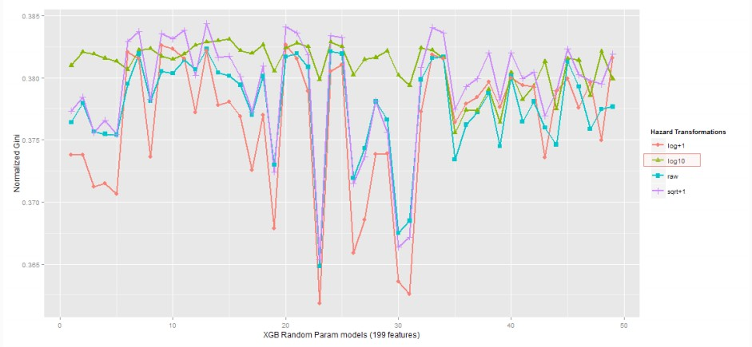
Target Transformation
In Liberty Mutual Group: Property Inspection Prediction Competition
Different transformations might lead to different results

Slide 38
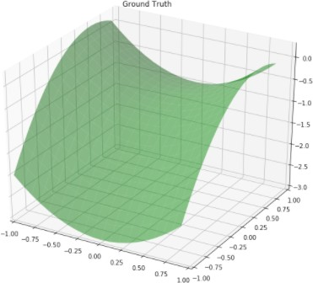
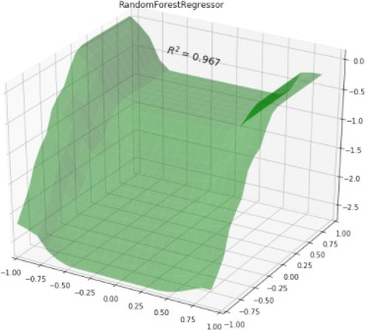
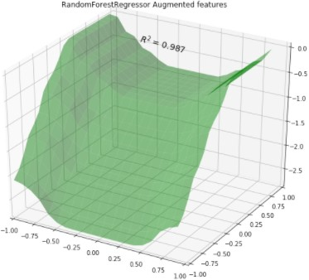
Feature Interaction
𝑦 = 𝑥₌> − 𝑥>> + 𝑥> − 1
Adding 𝑥₌> and 𝑥>>
as new features

Slide 39
Feature Interaction – how to find?
Domain knowledge
ML algorithm behavior (for example analyzing GBM splits or linear regressor weights)
Feature Interaction – how to model?
Math operations (sum, div, mul, sub)
Clustering and kNN for numerical features
Target encoding for pairs (or even triplets and etc.) of categorical features
Encode categorical features by stats of numerical features

Slide 40
Thank you!
Q&A

